Slide 1

PeTgo
Mobile Application development

Slide 2

Introductions
Riyazh
Adarsh
Manisha
Latriss

Slide 3

Agenda
Problem
Solution
Collaboration
Planning
Tools
Challenges
Demonstration
Future Updates
Questions

Slide 4

Idea
Pet Owners with insufficient time
Pet Owners without cars
Pet Owners with large pets or unsafe for cars

Slide 5
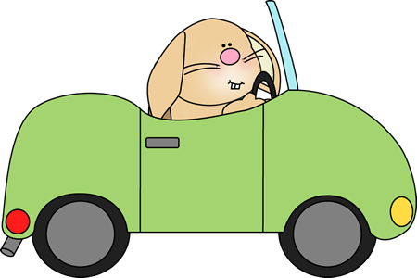
Solution
PetGo is an iOS mobile application which provides services for your pets.
Vet Services of all types
Pick-Ups & Drop-Offs

Slide 6



Collaboration
GitHub
One repository of all code
https://github.com/riyazhdholakia/PetVet
WhatsApp
To have message flow , daily communication, and status checks
Google Drive
File sharing

Slide 7
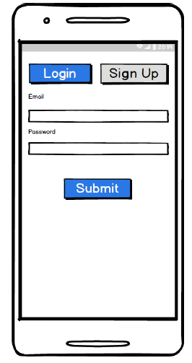
Planning
Entities
Use cases and user stories (next page)
Workflow (coming up)
Storyboard (example to the right)

Slide 8
User Stories
As a user of a PetVet app, I would like to sign up to make an account to use this app for pet services.
As a user of PetVet app, I would like a login information so I can login to set up a service.
As a user of PetVet app, I would like to setup a new service for my pet and my pet picked-up and dropped-off at a location, date, service of my choice, and clinic.
As a user of PetVet app, I would like to see to receive a confirmation number after I made a new pick-up.
As a user of PetVet app, I would like to keep track of all pick-up addresses and use them when setting a new pick-up. Ideally in my profile page.
As a user of PetVet app, I would like to keep track of all drop-off addresses and use them when setting a new pick-up. Ideally in my profile page.
As a user of PetVet app, I would like to keep track of all pets and use them when setting a new pick-up. Ideally in my profile page.

Slide 9
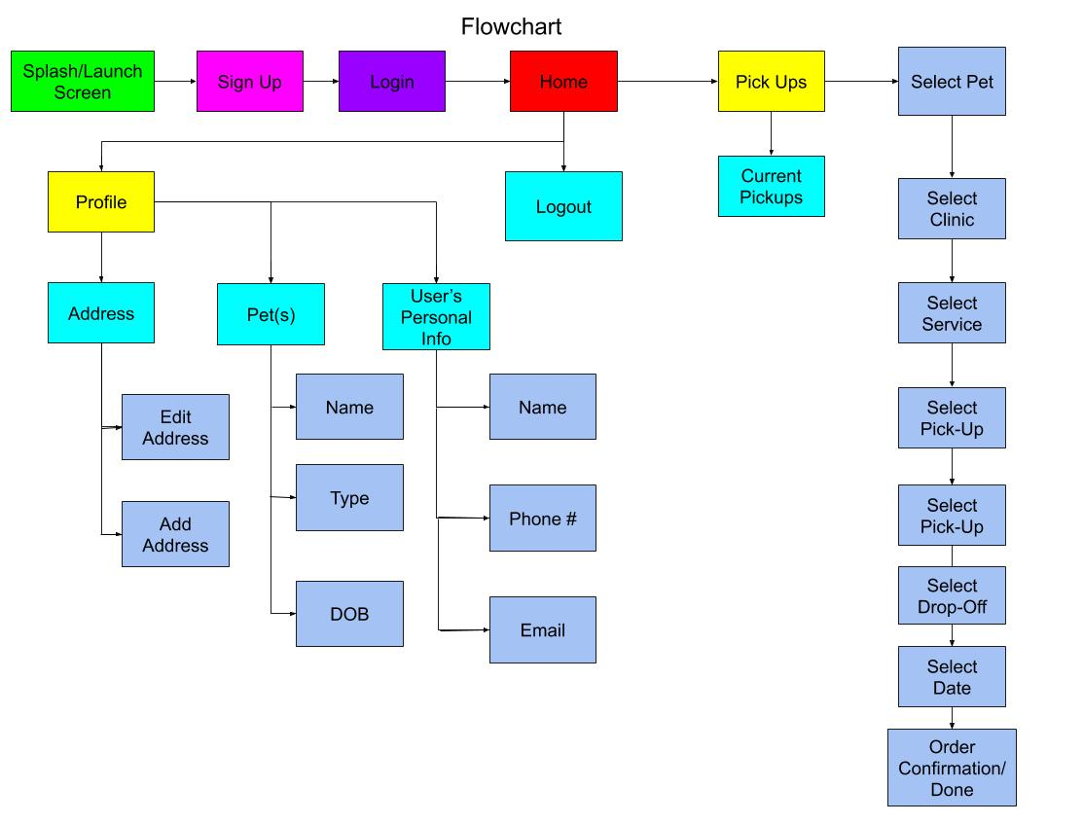
Workflow

Slide 10




Tools
Language: Swift
IDE: Xcode
Software Package Management System: Homebrew (helps install external software)
Application Level Dependency Manager: CocoaPods (handles external libraries)
Database: Firebase

Slide 11

Challenges
First time users to Firebase
First official big iOS App Project
Where to start?
Lack of UX/UI design knowledge
Needs vs. wants for features

Slide 12


Slide 13
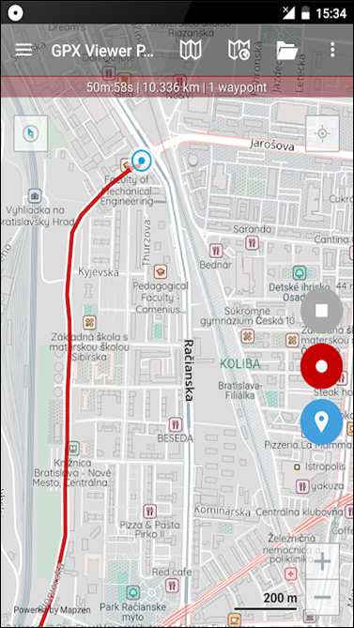
Future Updates
Push notifications to the app and or email/text
Maps showing exact location (like Uber)
Android App

Slide 14


Slide 15


